Slide 1
Levels of Testing
Unit Testing
Integration Testing
System Testing
Acceptance Testing
Alpha Testing
Unit Testing | Done by Developers
Integration Testing | Done by Testers
System Testing | Done by Testers
Acceptance Testing | Done by Users
Beta Testing
Gamma Testing

Slide 2
Unit Testing
Unit testing is done to check whether the individual modules of the source code are working properly.
That is testing each and every unit of the application separately by the developer in the develops environment.

Slide 3
Integration Testing
Integration testing is the process of testing the connectivity or data transfer between a couple of unit tested module.
Integration testing is done by testers.
Three ways of integration testing.
Top-Down Approach
Bottom–Up Approach
Big-Bang Approach

Slide 4
Top-Down Approach
The higher level modules are tested first and lower level modules are tested and integrated in order to check the software functionality.
Stubs are used for testing if some modules are not ready.
Bottom-Up Approach
Bottom up integration testing is a strategy in which the lower level modules are tested first. These tested modules are then further used to facilitate the testing of higher level modules.
Drivers are used when some modules are missing and unavailable at time of testing of a specific module.

Slide 5
Big Bang Testing
Big bang testing is an integration testing approach in which all the components or modules are integrated together at once and then tested as a unit.
If all of the components in the unit are not completed, the integration process will not execute.
Convenient for small systems.

Slide 6
System Testing
Testing the fully integrated application, this is also called end to end scenario testing.
To ensure that the software works in all intended target system.
Verify through testing to every input in the application to check for the desired output.
Testing is done by testers.

Slide 7
User Acceptance testing (end user Testing)
It is defined as testing the software by the user or client to determine whether it can be accepted or not. Acceptance means approval or agreement.
Alpha Testing
Beta Testing
Gamma Testing

Slide 8
Alpha Testing
It is a type of acceptance testing performed to identify all possible issues and bugs before releasing the final product to users.
Alpha testing is carried out by testers and the internal employees of the organization.
Alpha testing is performed at Developers site.

Slide 9
Beta Testing
Beta testing is performed at Clients Environment.
Performed by ‘real users’of the software application in real environment & it can be considered as a form of external UAT.
It is the final test before shipping a product to the customer.
Direct feed back from the customer is a major advantage of beta testing.

Slide 10
Gamma Testing
It is done when the software is ready for release with all the specified requirements.
Gamma testing focuses on software security and functionality

Slide 11
Testing Methods
Black Box Testing
White Box Testing
Grey Box Testing

Slide 12
Black Box Testing (closed box testing)
A tester does not have any information about the internal working of the software system.
Black box testing focuses on testing software functionality without knowing the internal code or logic. It ensures the system behaves as expected.
Black Box Testing is high level of testing that focuses on behavior of the software.
It involves testing from an external or end user perspective.
It can be applied to virtually every level of software testing (system testing, acceptance testing).

Slide 13
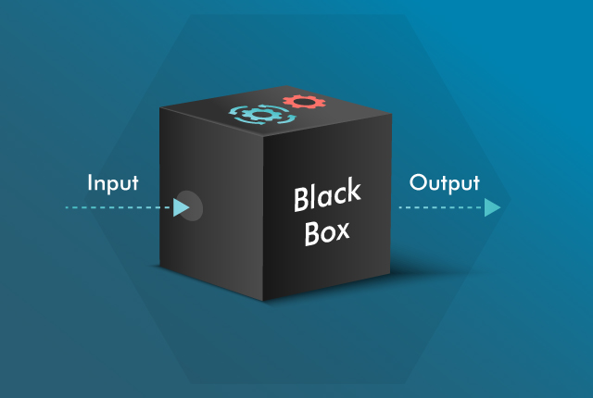
Black Box Testing

Slide 14
black box testing techniques
Equivalence Class Partitioning
Boundary Value Analysis
Decision Table Testing
State Transition Testing

Slide 15
Equivalence class partitioning
In this techniques input data units are divided in to equivalent partitions.(valid and invalid groups)
Tests one value from each group instead of all possible values.
That can be used to derive test cases which reduces time requires for testing

Slide 16
Equivalence class partitioning
Invalid | Valid | Invalid
Below 18 | 18 - 60 | Above 60
Eg :10 | 20 | 61

Slide 17
Equivalence class partitioning
Grade | Grade Point | Mark Range
S | 10 | 91-100
A+ | 9 | 81-90
A | 8 | 71-80
B+ | 7 | 61-70
B | 6 | 50-60
C | 0 | 0-49 OR <50

Slide 18
Boundary Value Analysis
In boundary value analysis ,We test boundary's between equivalence partitions .
Enter your age (only 18 to 60 are allowed for this ride)
Invalid | Valid | Invalid
Min-1 | Min,Min+1,Max,Max-1 | Max+1
17 | 18,19,60,59 | 61

Slide 19
Decision Table Testing
It is a tabular representation of input rules or conditions.
It helps to check all possible combinations of conditions on testing
It helps to design test cases based on the combinations of inputs and outputs for a system.

Slide 20
Eg : User name and password fields in a login page.
User name | Password | Output
F | F | F
T | F | F
F | T | F
T | T | T

Slide 21
State Transition TESTING
State transition testing is a black box testing technique in which changes in input conditions cause changes in the system's state and output.
Testers can provide positive and negative input test values and record the system behavior.
It helps to analyze behavior of an application for different input conditions.

Slide 22
State Transition Diagram
Incorrect PIN
Incorrect PIN
Start
1st Try
2nd Try
3rd Try
Correct PIN
Correct PIN
Incorrect PIN
Correct PIN
Access granted
Account Blocked

Slide 23
White Box Testing (glass box testing)
It is a testing method which check the internal functioning of the system. It is done by developers or testers with programming knowledge.
White box testing helps find hidden errors early by analyzing the code directly.
In this method testing is based on coverage of code statements, branch,path,conditions.
It is considered as low level testing.(unit testing)

Slide 24
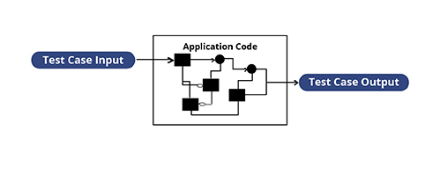
White box testing
Output

Slide 25
White Box Testing Techniques
Statement Coverage
Decision Coverage
Condition Coverage
Branch Coverage

Slide 26
Statement Coverage
It is a white box testing technique in which all the executable statements in the source code are executed at least once.(Ensures every line of code is executed at least once.)
Statement Coverage = No.of executed statement *100
Total no.of statement

Slide 27
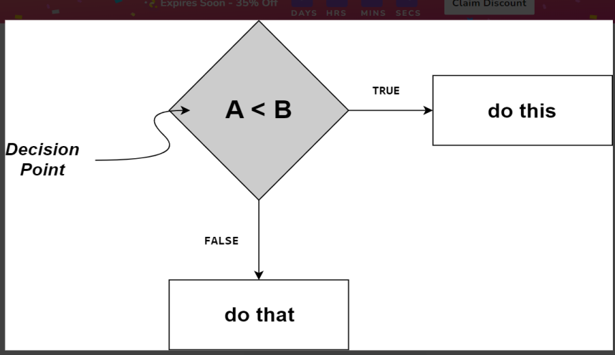
Decision Coverage
It is a white box testing technique which check and ensure that each branch of every possible decision point is executed at least once. It ensures that every possible outcome of the entire decision is tested.
Decision coverage= No.ofdecisionexecuted*100
Total number of decision

Slide 28
Condition Coverage
It is a testing method used to evaluate each variable or sub-expression within a conditional statement. It tests every possible outcome of each sub-expression to ensure that all scenarios are covered.
Example: if (x > 1 && y > 0) condition coverage requires testing:
x = 2, y = 1
x = 2, y = -1
x = -1, y = 1
x = -1, y = -1
Real-Time Example:
Suppose your rule to go outside is:
"I will go outside if it's sunny AND I have an umbrella."
In code:
python
if isSunny and haveUmbrella: goOutside()
Here, the condition is:
isSunny AND haveUmbrella
These are two sub-conditions:
isSunny
haveUmbrella
✅ Condition Coverage means:
Test each sub-condition (isSunny, haveUmbrella) once as true and once as false, no matter what the full condition result is.
🧪 Test Cases to Cover All Possibilities:
Test CaseisSunnyhaveUmbrellaCan go outside?1truetrueYes2truefalseNo3falsetrueNo4falsefalseNo
✅ What we achieved:
isSunny is true in Test 1 and 2, false in Test 3 and 4 ✅
haveUmbrella is true in Test 1 and 3, false in Test 2 and 4 ✅
So, each part (condition) has been tested for true and false → ✔️ Condition Coverage Achieved!

Slide 29
Branch Coverage
It is a white Box testing method in which every outcome from a code module (statement or loop)is tested.

Slide 30
Grey Box Testing
It is a combination of Black Box and White Box technique.
It is a software techniques to test a software product or application with partial knowledge of internal structure of the application.
You know a bit about the internal workings of the application (like how modules interact, databases, or APIs), but you're still testing it from the user’s perspective.

Slide 31
Error Guessing
It is a software testing technique based on guessing the error which can prevail in the code.
The technique is heavily based on the experience where the test analysts use their experience to guess the problematic part of the testing application hence the test analysts must be skilled and experienced for better error guessing.
Guideline for error guessing
The tester should use the previous experience of testing similar applications
Understanding of the system under test
Knowledge of typical implementation errors
Remember previously troubled areas.
Evaluate historical data and test results

